Slide 1
IoT Security
Academy of Cryptography Techniques
CHAT
Dr. Pham Van Huong
0902 122 010
HuongPV@gmail.com

Slide 2
Contents
1
Basic concepts
2
Threats, Vulnerabilities, Attacks, Risks
3
Threat modeling an IoT system
5

Slide 3
The classic pillars of information assurance
Confidentiality:
Keeping sensitive information secret and protected from disclosure
Integrity:
Ensuring that information is not modified, accidentally or purposefully, without being detected
Authentication:
Ensuring that the source of data is from a known identity or endpoint (generally follows identification)
Non-repudiation:
Ensuring that an individual or system cannot later deny having performed an action
Availability:
Ensuring that information is available when needed

Slide 4
Threats
It is important to distinguish between a threat and threat source (or threat actor)
Each threat has a threat actor
Threats may therefore come in a variety of types, both natural and man-made
Tornados, floods, and hurricanes can be considered natural threats
IoT threats include all of the information assurance threats to management and application data sent to and from IoT devices
In addition, IoT devices are subject to the same physical security, hardware, software quality, environmental, supply chain

Slide 5
Vulnerability
Vulnerability is the term we use to identify a weakness, either in the design, integration, or operation of a system or device
Vulnerabilities are ever-present, and countless new ones are discovered every day
Many online databases and web portals now provide us with automated updates on newly discovered vulnerabilities

Slide 6
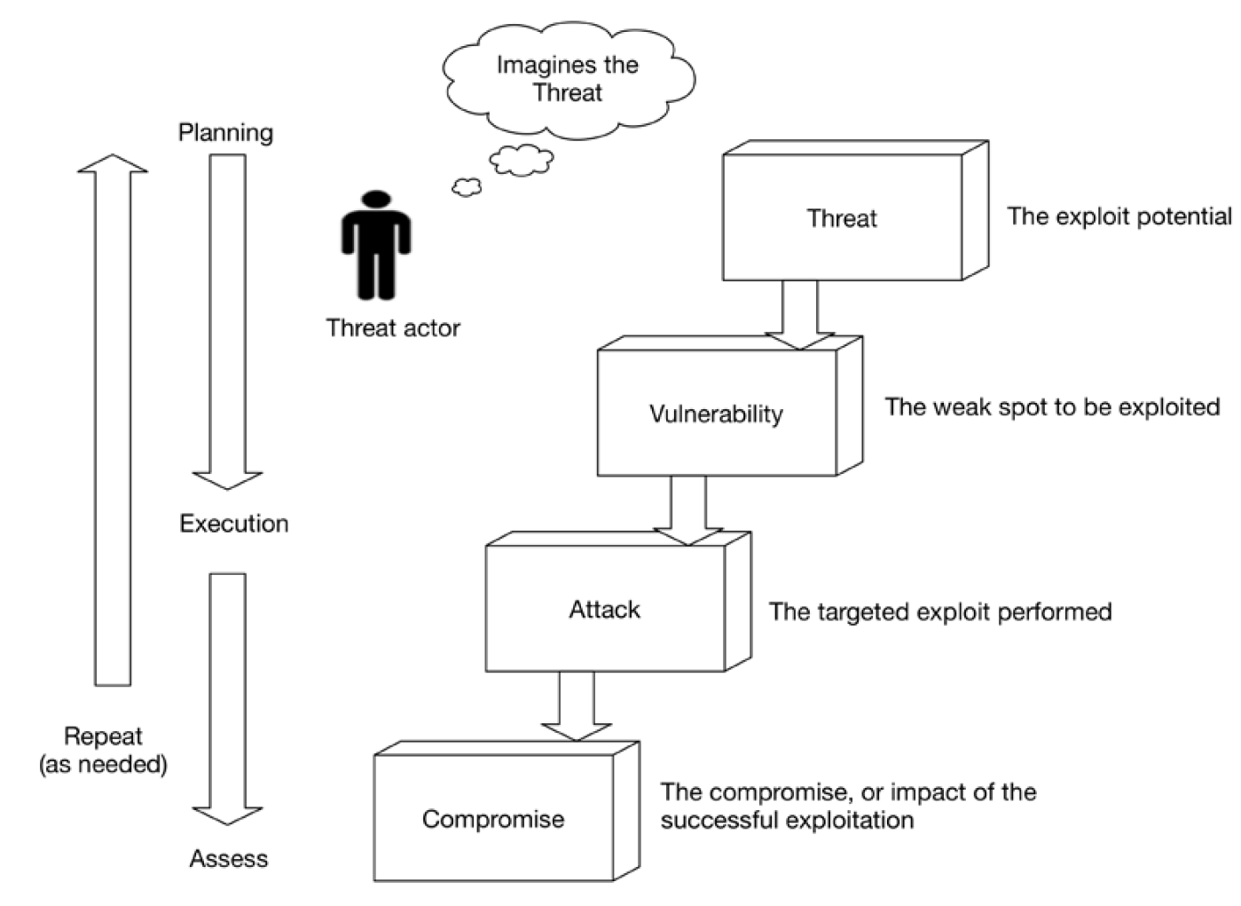
Vulnerability
https://wiki.owasp.org/index.php/OWASP_Internet_of_Things_Project#IoT_Vulnerabilities

Slide 7
Vulnerability
Vulnerability | Attack Surface | Summary
Username Enumeration | Administrative Interface Device Web Interface Cloud Interface Mobile Application | Ability to collect a set of valid usernames by interacting with the authentication mechanism
Weak Passwords | Administrative Interface Device Web Interface Cloud Interface Mobile Application | Ability to set account passwords to '1234' or '123456' for example. Usage of pre-programmed default passwords
Account Lockout | Administrative Interface Device Web Interface Cloud Interface Mobile Application | Ability to continue sending authentication attempts after 3 - 5 failed login attempts
Unencrypted Services | Device Network Services | Network services are not properly encrypted to prevent eavesdropping or tampering by attackers

Slide 8
Vulnerability
Two-factor Authentication | Administrative Interface Cloud Web Interface Mobile Application | Lack of two-factor authentication mechanisms such as a security token or fingerprint scanner
Poorly Implemented Encryption | Device Network Services | Encryption is implemented however it is improperly configured or is not being properly updated, e.g. using SSL v2
Update Sent Without Encryption | Update Mechanism | Updates are transmitted over the network without using TLS or encrypting the update file itself
Update Location Writable | Update Mechanism | Storage location for update files is world writable potentially allowing firmware to be modified and distributed to all users
Denial of Service | Device Network Services | Service can be attacked in a way that denies service to that service or the entire device
Removal of Storage Media | Device Physical Interfaces | Ability to physically remove the storage media from the device

Slide 9
Vulnerability
No Manual Update Mechanism | Update Mechanism | No ability to manually force an update check for the device
Missing Update Mechanism | Update Mechanism | No ability to update device
Firmware Version Display and/or Last Update Date | Device Firmware | Current firmware version is not displayed and/or the last update date is not displayed
Firmware and storage extraction | JTAG / SWD interface In-Situ dumping Intercepting a OTA update Downloading from the manufacturers web page eMMC tapping Unsoldering the SPI Flash / eMMC chip and reading it in a adapter | Firmware contains a lot of useful information, like source code and binaries of running services, pre-set passwords, ssh keys etc.

Slide 10
Vulnerability
Manipulating the code execution flow of the device | JTAG / SWD interface Side channel attacks like glitching | With the help of a JTAG adapter and gdb we can modify the execution of firmware in the device and bypass almost all software based security controls. Side channel attacks can also modify the execution flow or can be used to leak interesting information from the device
Obtaining console access | Serial interfaces (SPI / UART) | By connecting to a serial interface, we will obtain full console access to a device Usually security measures include custom bootloaders that prevent the attacker from entering single user mode, but that can also be bypassed.
Insecure 3rd party components | Software | Out of date versions of busybox, openssl, ssh, web servers, etc.

Slide 11
Risks
One can use qualitative or quantitative methods for evaluating risk
Simply put, risk is one's exposure to loss.
It is different from vulnerability, because it depends on the probability of a particular event, attack, or condition and has a strong link to the motivations of an attacker.

Slide 12
Risks
Risk can be managed through threat modeling, which helps ascertain the following:
Impact and overall cost of a compromise
How valuable the target may be to attackers
Anticipated skill and motivations of the attackers (based on threat modeling)
A priori knowledge of a system's vulnerabilities (for example, those discovered during threat modeling, public advisories, penetration testing, and so on)

Slide 13
Common IoT attack types
Wired and wireless scanning and mapping attacks
Protocol attacks
Eavesdropping attacks (loss of confidentiality)
Cryptographic algorithm and key management attacks
Spoofing and masquerading (authentication attacks)
Operating system and application integrity attacks
Denial of service and jamming
Physical security attacks
Access control attacks (privilege escalation)

Slide 14
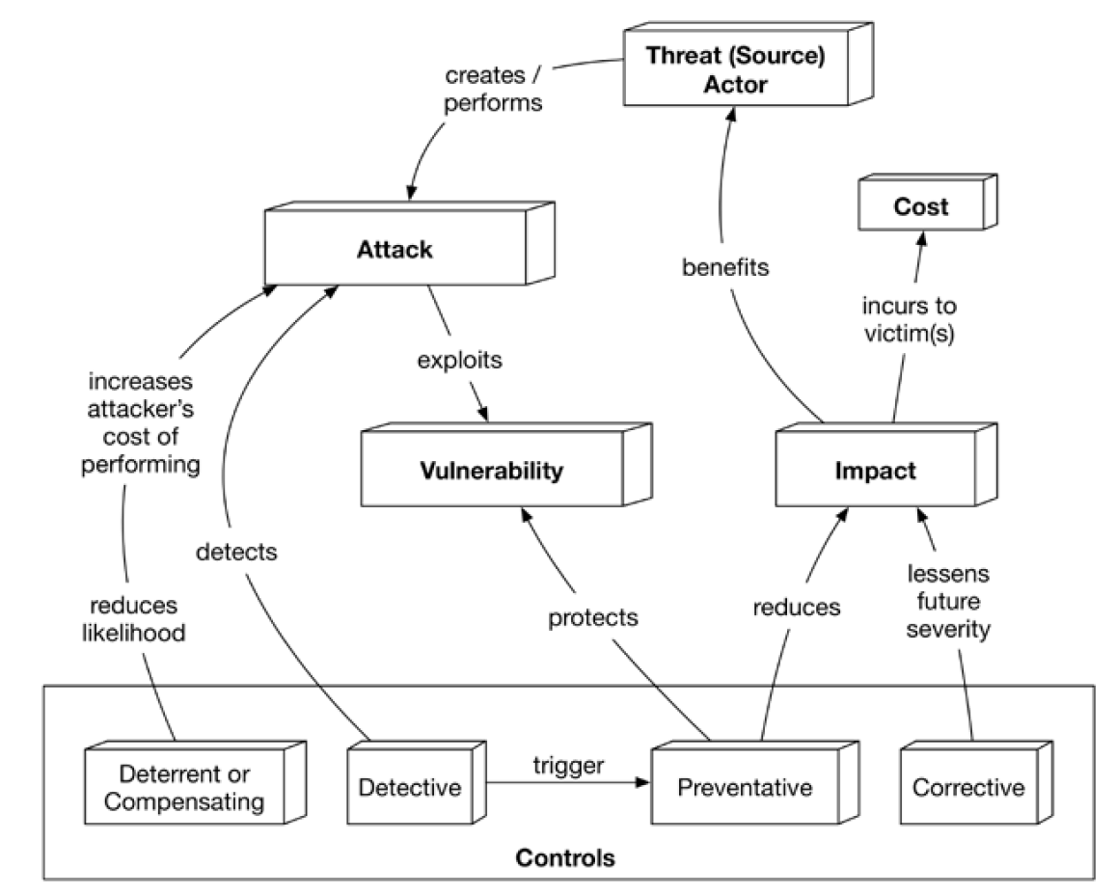
Common IoT attack types
The following diagram shows the ecosystem of attacks, vulnerabilities, and controls:

Slide 15
IoT Attack Surface
Attack Surface | Vulnerability
Ecosystem (general) | Interoperability standards Data governance System wide failure Individual stakeholder risks Implicit trust between components Enrollment security Decommissioning system Lost access procedures
Device Memory | Sensitive data Cleartext usernames Cleartext passwords Third-party credentials Encryption keys

Slide 16
IoT Attack Surface
Device Physical Interfaces | Firmware extraction User CLI Admin CLI Privilege escalation Reset to insecure state Removal of storage media Tamper resistance Debug port UART (Serial) JTAG / SWD Device ID/Serial number exposure
Device Web Interface | Standard set of web application vulnerabilities, see: OWASP Web Top 10; OWASP ASVS; OWASP Testing guide Credential management vulnerabilities: Username enumeration Weak passwords Account lockout Known default credentials Insecure password recovery mechanism

Slide 17
IoT Attack Surface
Device Firmware | Sensitive data exposure (See OWASP Top 10 - A6 Sensitive data exposure): Backdoor accounts Hardcoded credentials Encryption keys Encryption (Symmetric, Asymmetric) Sensitive information Sensitive URL disclosure Firmware version display and/or last update date Vulnerable services (web, ssh, tftp, etc.) Verify for old sw versions and possible attacks (Heartbleed, Shellshock, old PHP versions etc) Security related function API exposure Firmware downgrade possibility

Slide 18
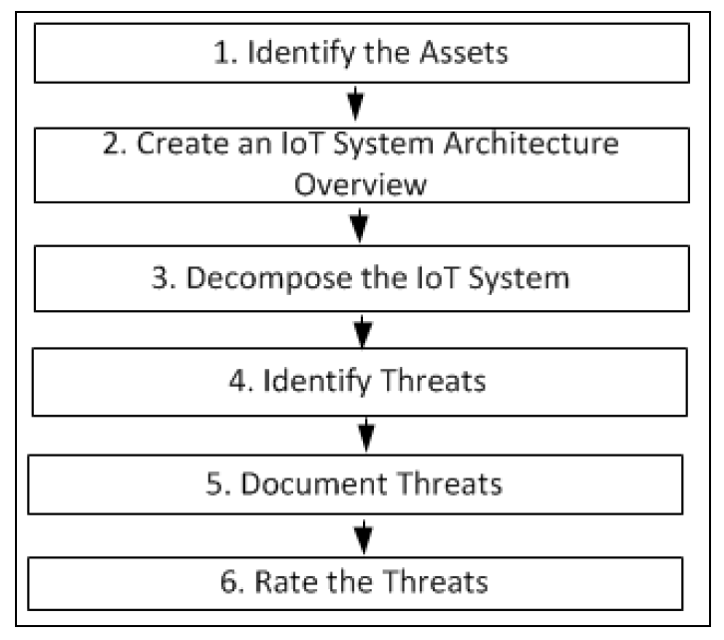
Threat modeling an IoT system
Microsoft also defines a well-thought-out threat modeling approach using multiple steps to determine the severity of threats introduced by a new system

Slide 19
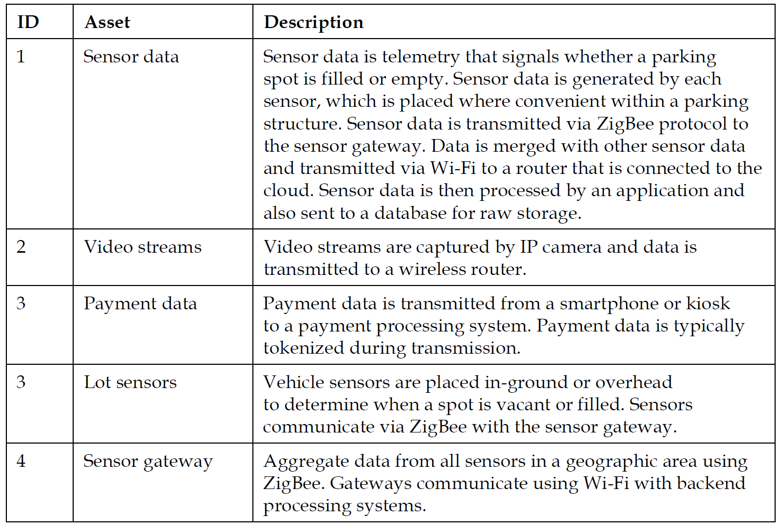
Step 1 – identify the assets

Slide 20
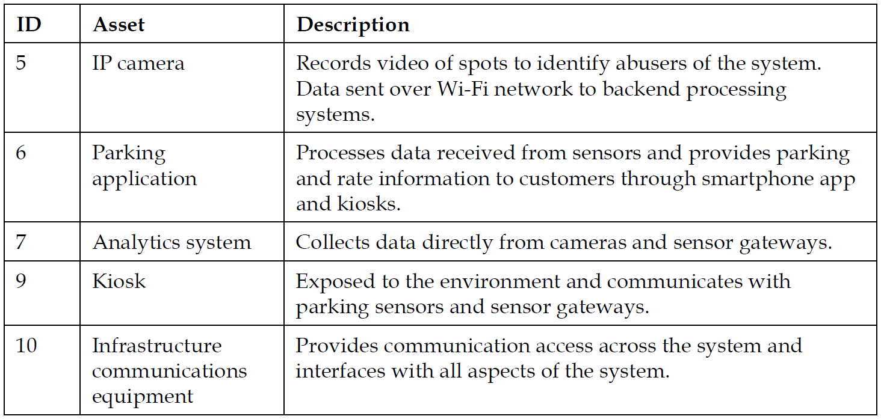
Step 1 – identify the assets

Slide 21
Step 2 – create a system/architecture overview
Start with documenting expected functionality.
Create an architectural diagram that details the new IoT system.
During this process, trust boundaries in the architecture should be established
Trust boundaries should elucidate the trust between actors, and their directionality.
Identify technologies used within the IoT system.

Slide 22
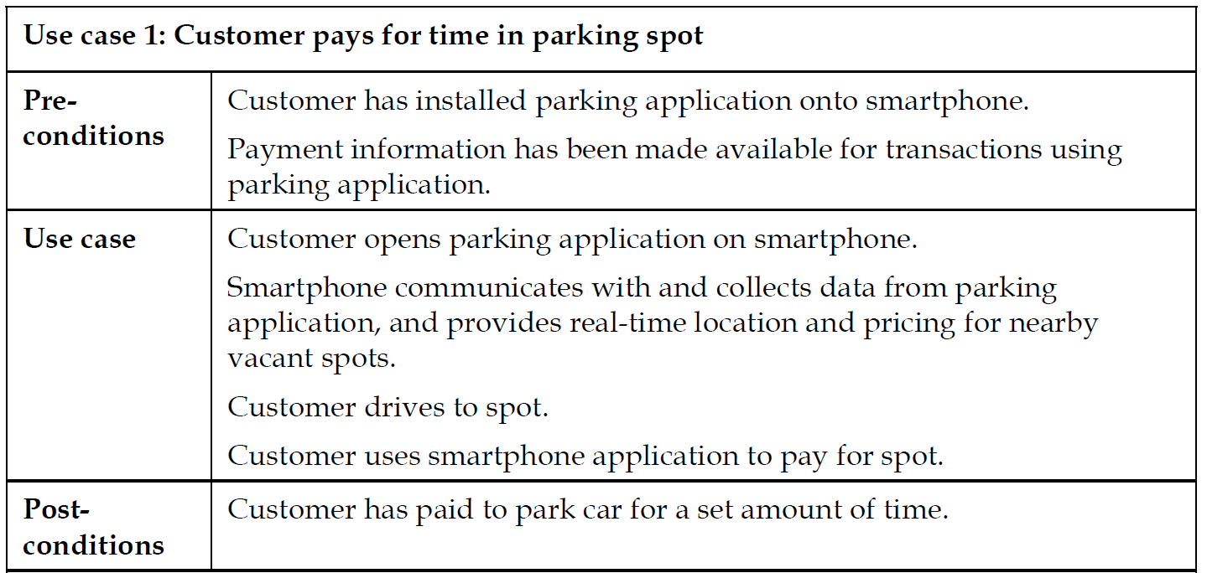
Step 2 – create a system/architecture overview
Documentation of system functionality is best accomplished by creating a set of use cases such as those that follow:

Slide 23
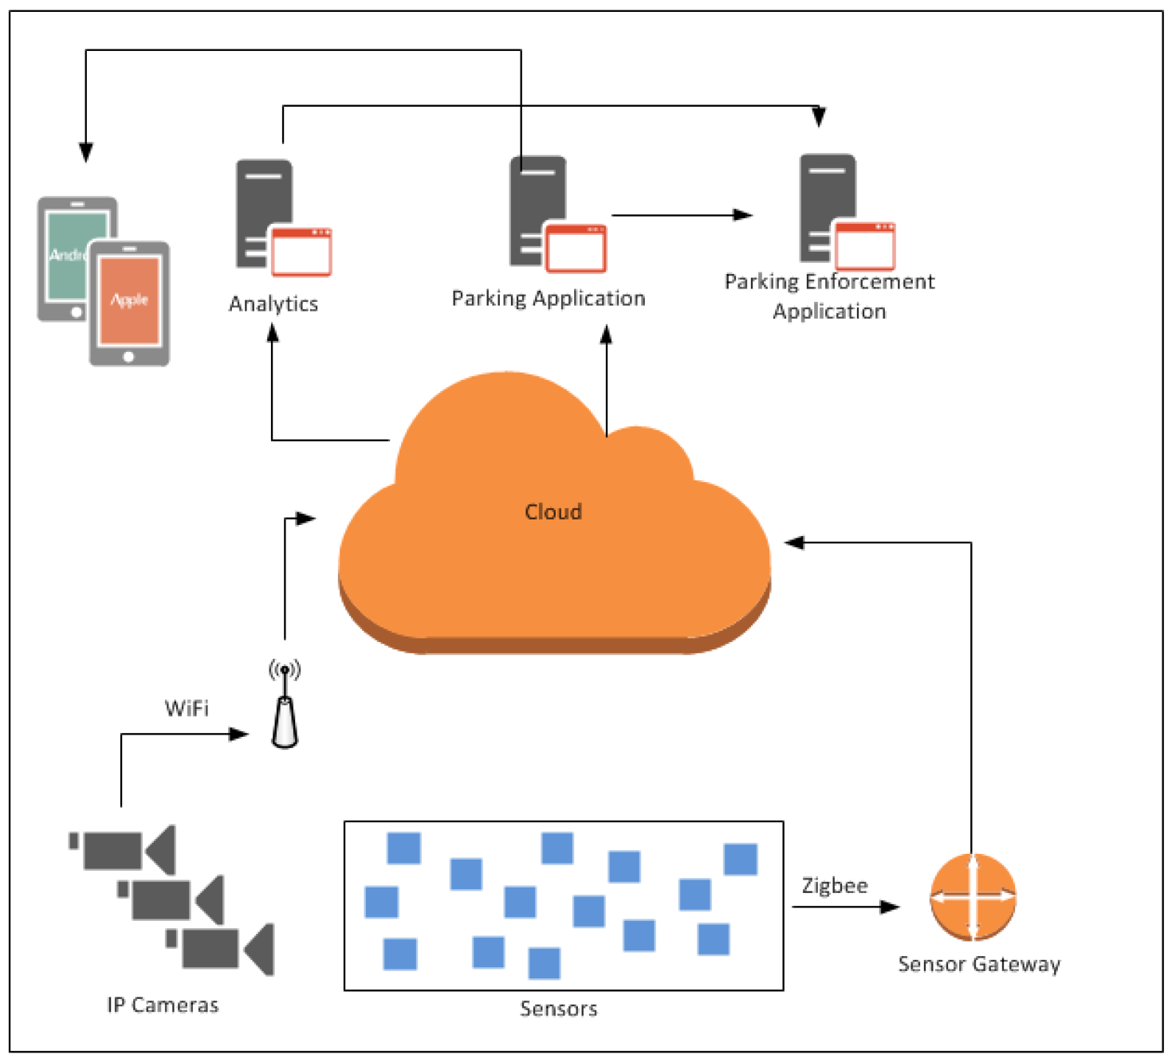
Step 2 – create a system/architecture overview
The following figure is an architectural diagram of our example smart parking solution

Slide 24
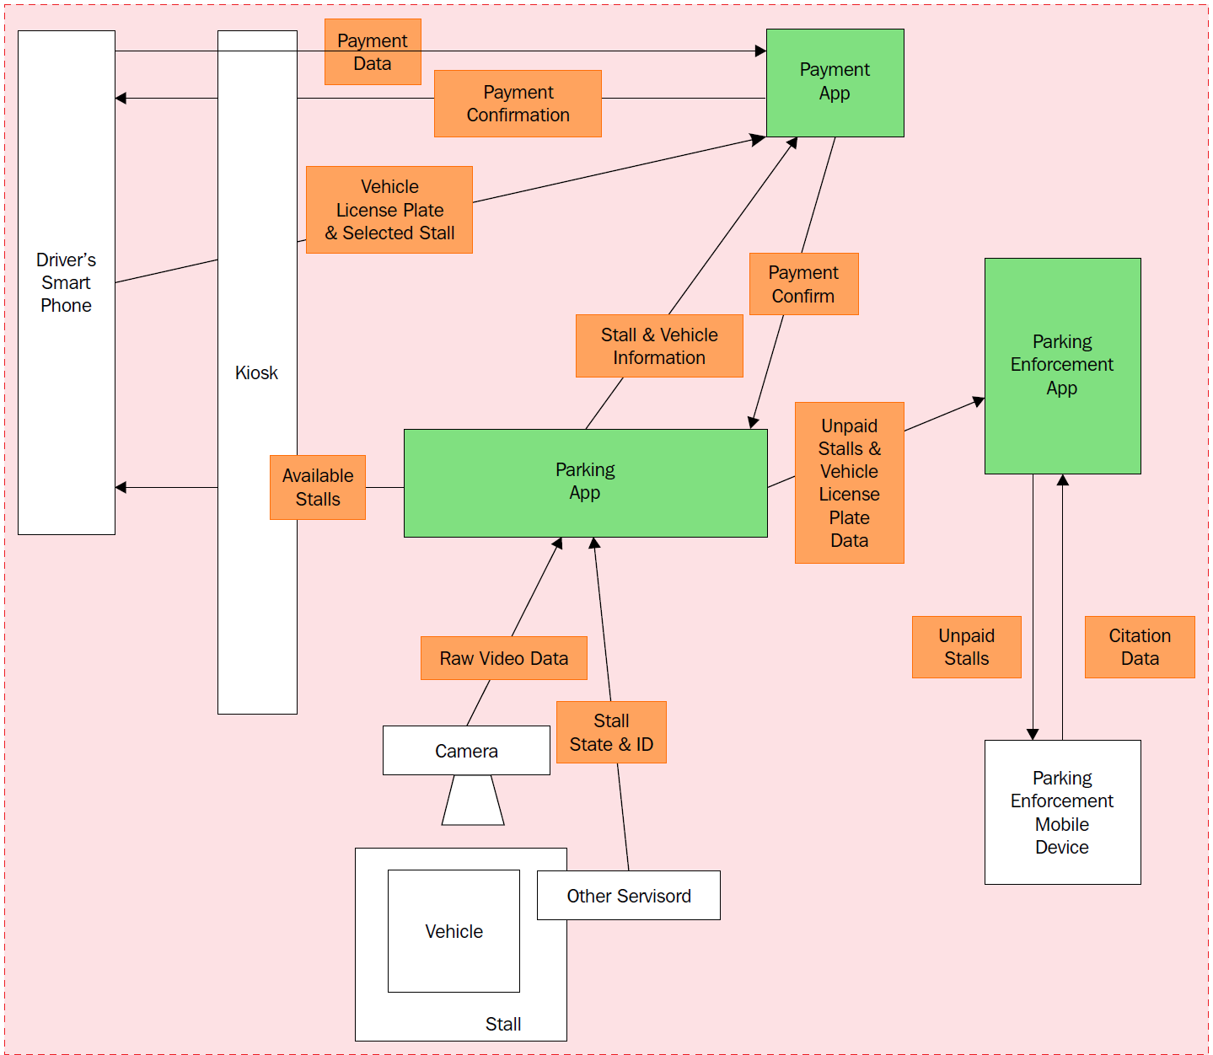
Step 3 – decompose the IoT system
At the end of this activity, a detailed understanding of the IoT system's attack surface (in terms of data sensitivity and system movements) emerges:

Slide 25
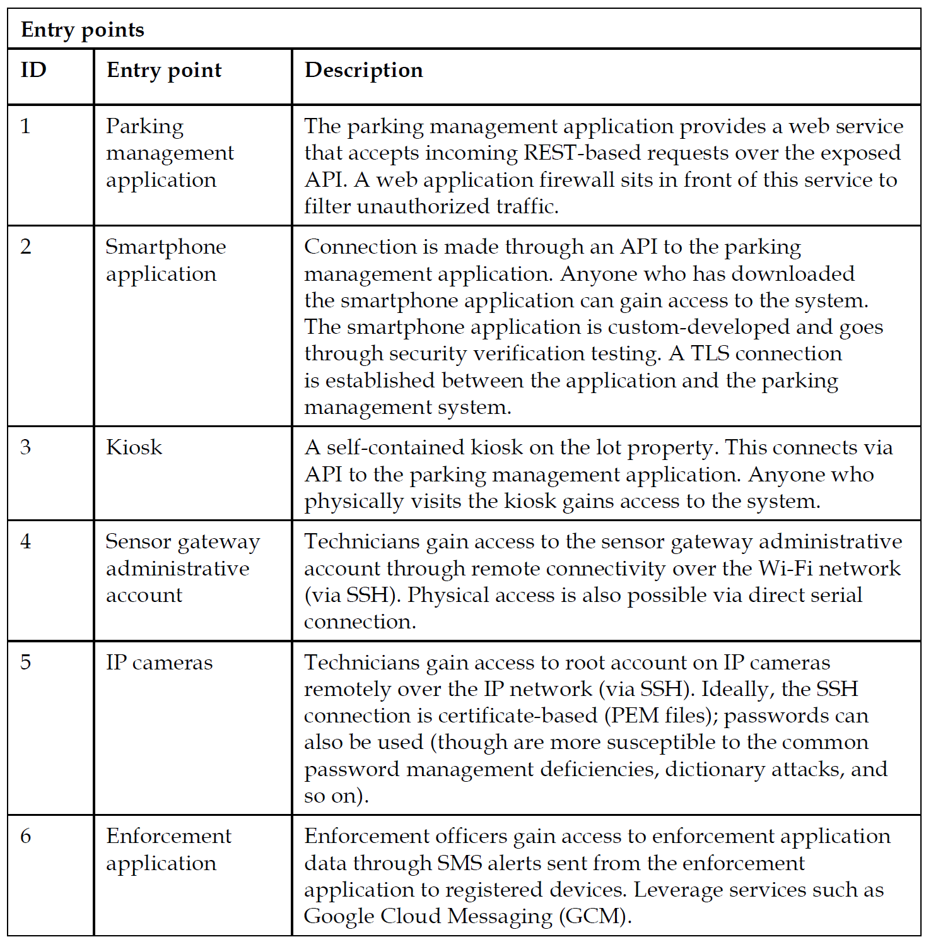
Step 3 – decompose the IoT system
The entry points and trust boundaries have an enormous security bearing as you identify overall threats associated with the system

Slide 26
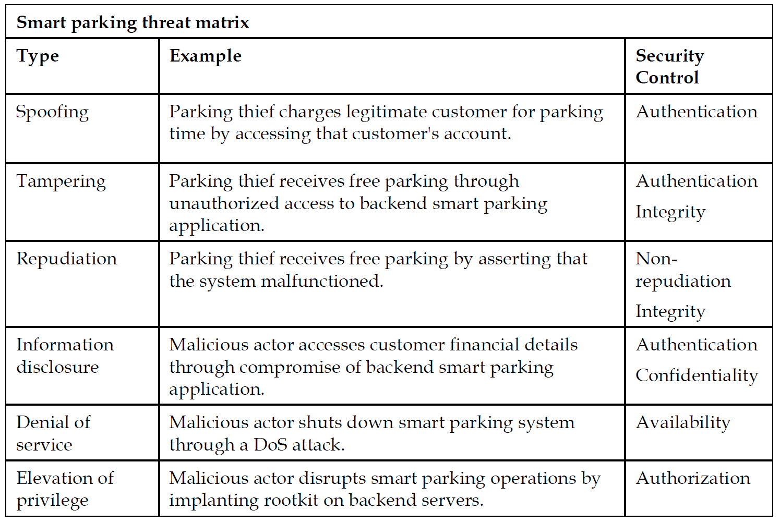
Step 4 – identify threats

Slide 27
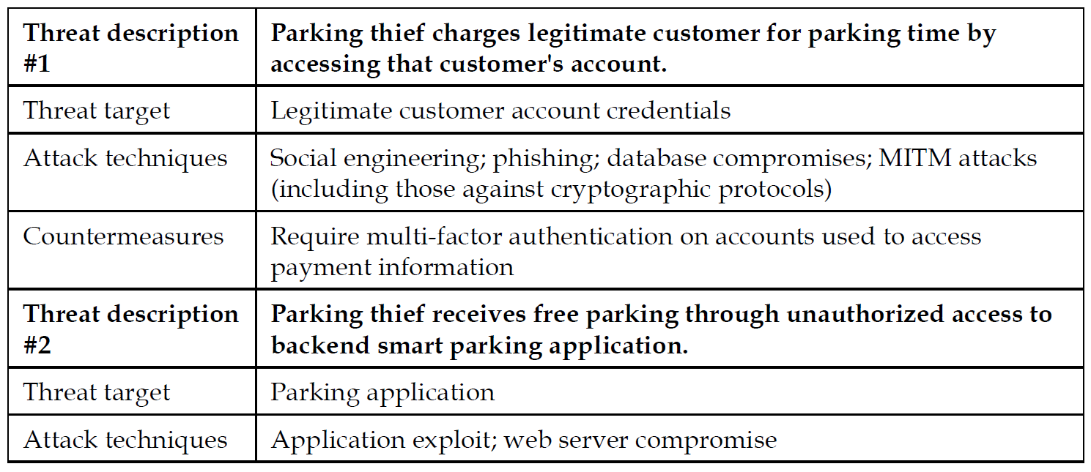
Step 5 – document the threats

Slide 28
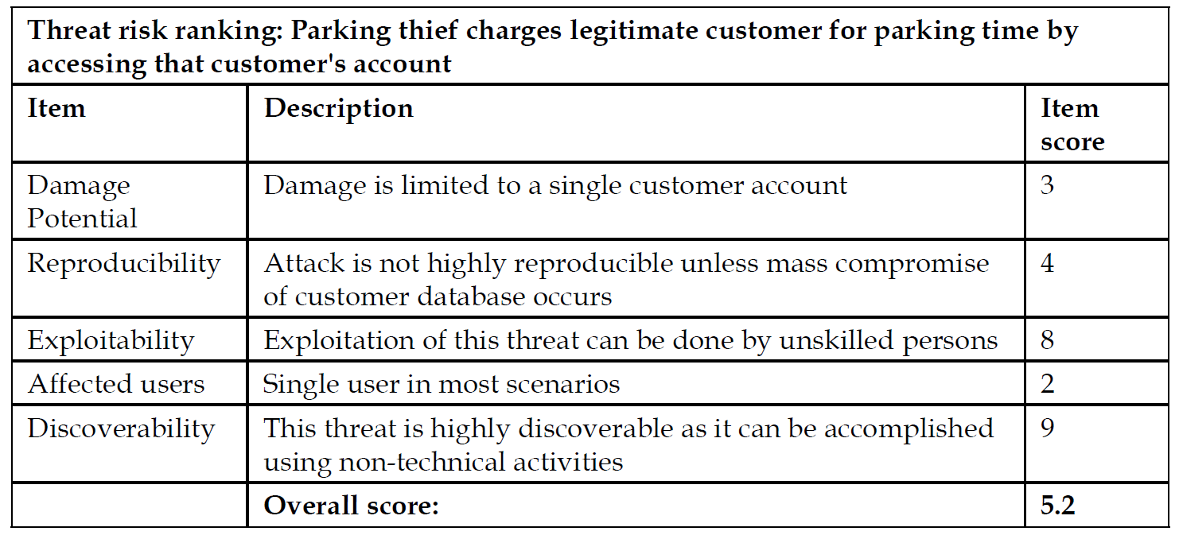
Step 6 – rate the threats
An example of a threat rating for our smart parking system is provided in the following table:

Slide 29
Q&A

